Slide 2

CSE 408:DESIGN AND ANALYSIS OF ALGORITHMS
Lecture: 0

Slide 3
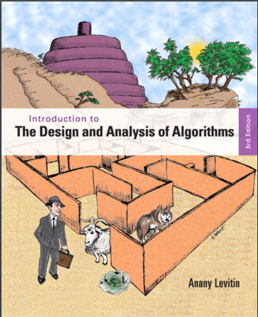
Course Details
LTP – 3 0 0 [Three lectures/week]
2. Text Book
INTRODUCTION TO THE
DESIGN AND ANALYSIS
OF ALGORITHM
by ANANY LEVITIN,PEARSON

Slide 4
Marks Breakup:
* 2 Best CA out of 3 CA (Class test, MCQ).
CA1 (Class Test) will be held on 5th Week
CA2 (Class Test) Will be held on 9th Week
CA3 (Class Test) Will be held on 12th Week
Activity | Marks
Attendance | 5
Continuous Assessment (CA)* | 25
Mid-Term Examination (MTE) | 20
End-Term Examination (ETE) | 50
Total | 100

Slide 5
